Slide 1
Software Construction and Development
Week 10
Instructor :M Khizar Hayat
Common Bugs and Debugging Techniques

Slide 2
Exception Handling in Java
Exception Handling
Exception Handling is a mechanism to handle runtime errors
Normal flow of the application can be maintained
It is an object which is thrown at runtime
Exception Handling done with the exception object
Real-Life Example
If an ATM machine temporarily loses internet connection, it should display an error message instead of shutting down completely.

Slide 3
What is an Exception?
Exception
An exception is an abnormal event that occurs during program execution
It interrupts the normal flow of instructions
Occurs at runtime
Generated automatically by JVM or manually by programmer
Can be handled using exception handling mechanisms

Slide 4
Common Examples
Division by zero
File not found
Invalid array index
Database connection failure
Invalid user input
Example
int result = 10 / 0;
This causes an ArithmeticException.

Slide 5
Need for Exception Handling
Why Exception Handling is Important?
Without exception handling, programs may terminate abruptly when an error occurs.
Benefits
Prevents application crashes
Enhances user experience
Makes applications more secure
Simplifies debugging and maintenance
Allows graceful recovery from errors

Slide 6
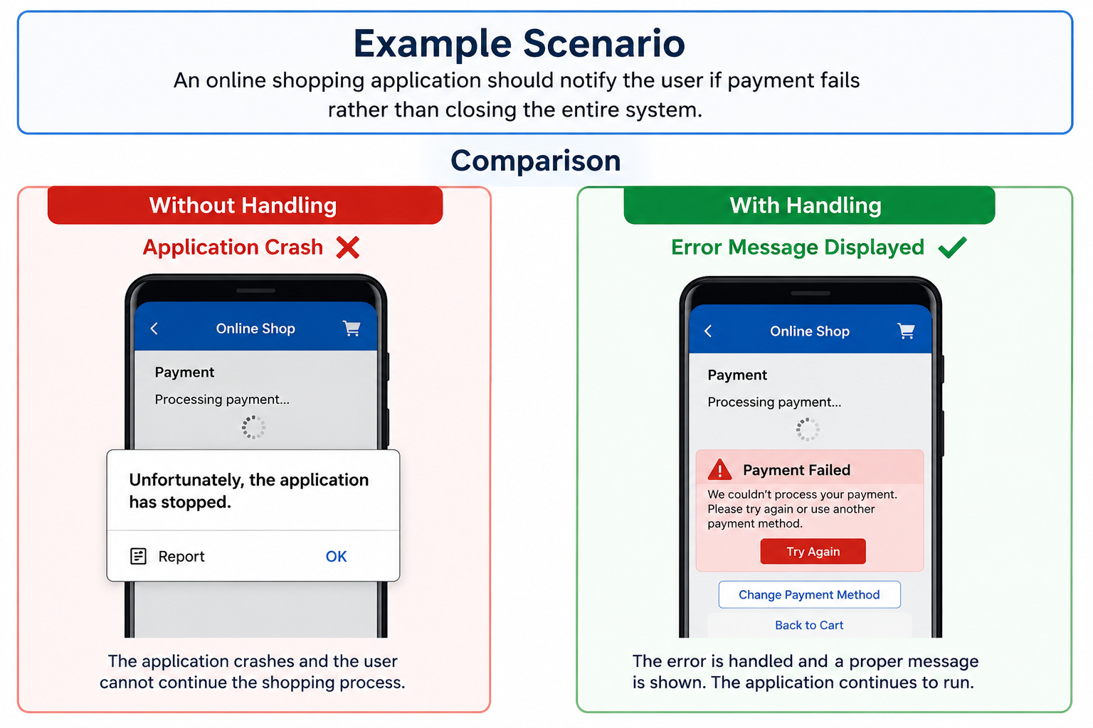
Example Scenario
An online shopping application should notify the user if payment fails rather than closing the entire system.

Slide 7
Types of Errors
There are three categories of errors:
  Syntax errors – arise because the rules of the language have not been followed. They are detected by the compiler
  Runtime errors – occur while the program is running if the environment detects an operation that is impossible to carry out
  Logic errors – occur when a program doesn't perform the way it was intended to.

Slide 8
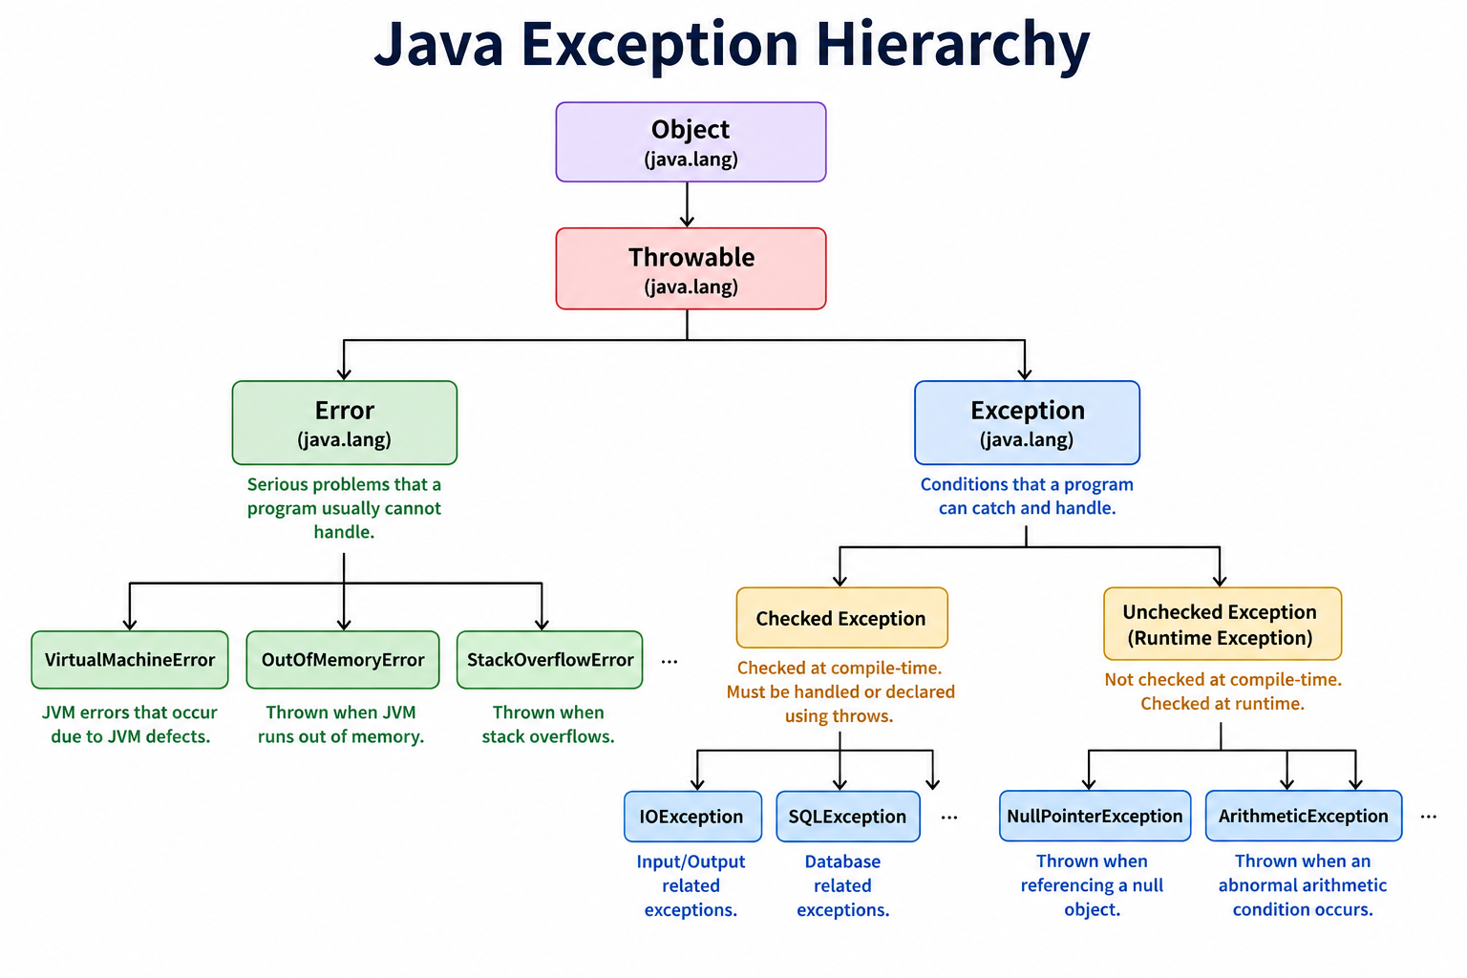
Java Exception Hierarchy

Slide 9
Types of Exception
There are mainly two types of exceptions:
Checked
Unchecked – Eg. error
The sun microsystem says there are three types of exceptions:
Checked Exception – are checked at compile-time
Unchecked Exception – are not checked at compile-time rather they are checked at runtime
Error – are not checked at compile-time and occur at runtime due to serious system problems

Slide 10
Checked Exception – Classes that extend Throwable class except Runtime Exception and error are known as checked exceptions. Checked Exceptions means that compiler forces the programmer to check and deal with the exceptions e.g. IOException, SQLException etc.
Unchecked Exception – Classes that extends RuntimeException, Error and their subclasses are known as unchecked exceptions e.g. ArithmeticException,NullPointerException,ArrayIndexOutOfBounds Exception etc.
Error is irrecoverable should not try to catch e.g. OutOfMemoryError, VirtualMachineError, AssertionError etc.

Slide 11
Exception Handling Keywords
Keyword Description
try Contains risky code
catch Handles exceptions
finally Executes regardless of exception
throw Used to manually throw exception
throws Declares possible exceptions
These keywords form the core of Java exception handling.

Slide 12
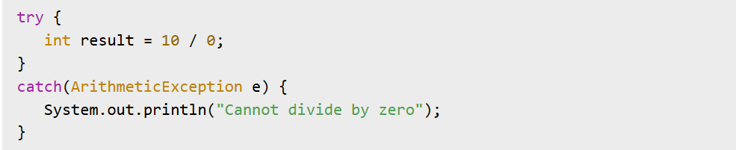
Try-Catch Block
Try-Catch Mechanism
The try block contains code that may generate an exception
While the catch block handles the exception
Syntax

Slide 13
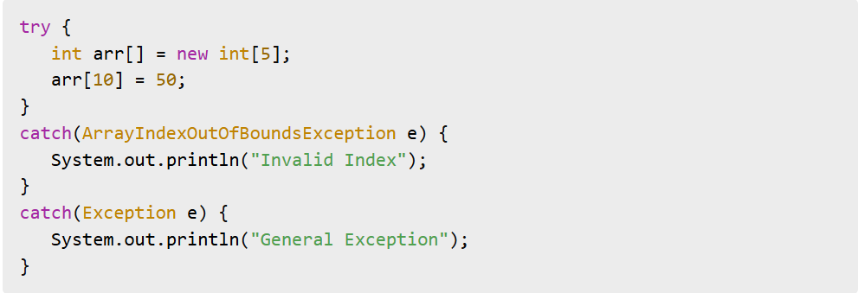
Multiple Catch Blocks
Handling Multiple Exceptions
A single try block may generate different exceptions
Example

Slide 14
Finally Block
Finally Keyword
The finally block always executes whether an exception occurs or not
Common Uses
Closing files
Releasing resources
Closing database connections
Example
finally {
System.out.println("Execution completed");
}

Slide 15
Throw Keyword
Throwing Exceptions Manually
The throw keyword is used to generate exceptions explicitly
Example
throw new ArithmeticException("Invalid operation");
Uses
Input validation
Business rules enforcement
Custom error generation

Slide 16
Throws Keyword
Declaring Exceptions
The throws keyword informs the caller that a method may generate exceptions
Example
public void readFile() throws IOException {
}
Advantages
Better exception propagation
Improves code readability

Slide 17
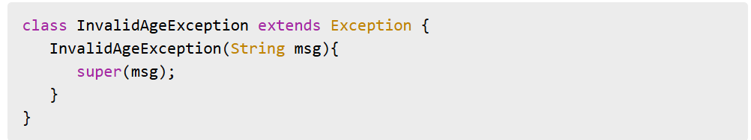
Custom Exceptions
User Defined Exceptions
Developers can create their own exceptions for application-specific problems
Example

Slide 18
Best Practices in Exception Handling
Recommended Practices
Guidelines
Catch specific exceptions
Avoid empty catch blocks
Use meaningful exception messages
Do not overuse exceptions
Always clean resources
Log exceptions properly

Slide 19
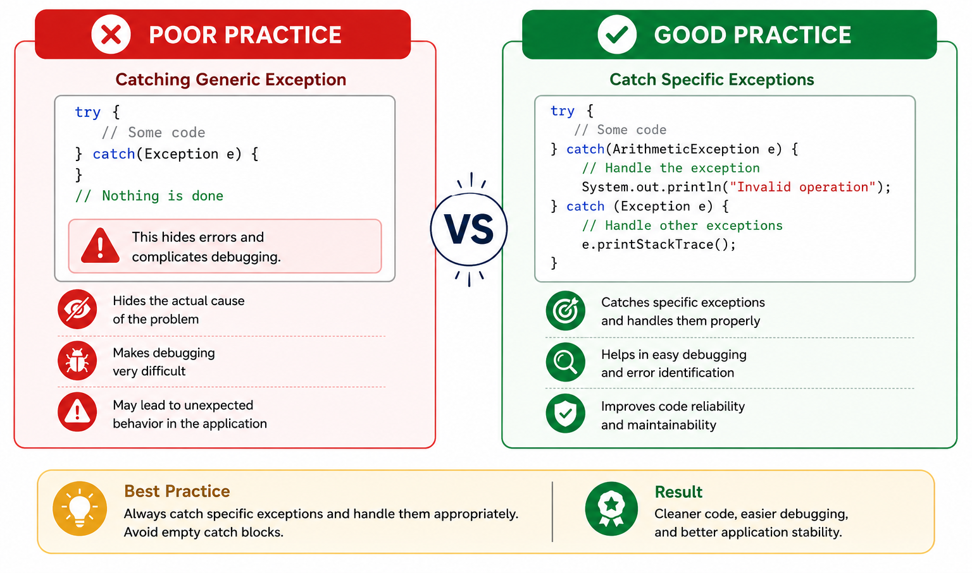

Slide 20
Introduction to Logging
Logging is the process of recording application events, warnings, and errors into files or consoles
Monitor application behavior
Identify system issues
Support debugging
Maintain application history

Slide 21
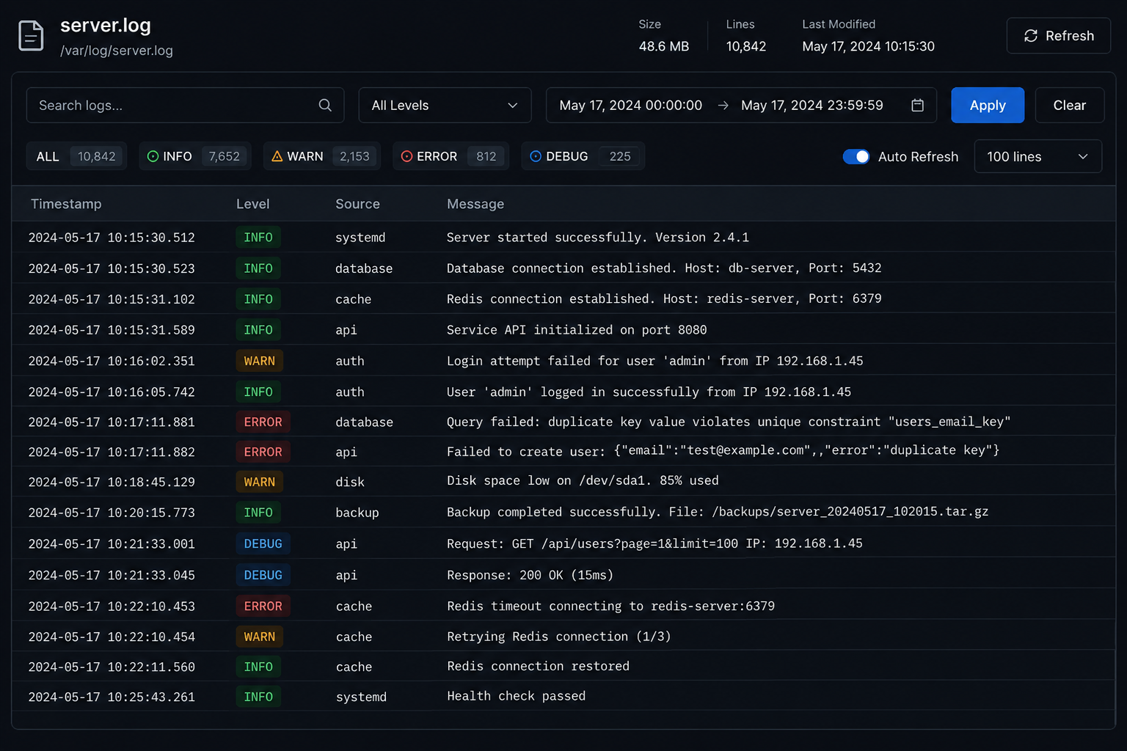
Logged Information
Errors
User actions
System events
Security events

Slide 22
Importance of Logging
Why Logging is Important?
Detects issues quickly
Assists troubleshooting
Provides system monitoring
Improves maintenance
Supports auditing and security
Example
Banking systems maintain logs for every transaction for security and tracking.

Slide 23
Introduction to SLF4J
SLF4J (Simple Logging Facade for Java)
SLF4J is a popular Java logging framework that provides abstraction for different logging libraries.
Features
Lightweight
Flexible
Easy integration
Supports multiple logging frameworks

Slide 24
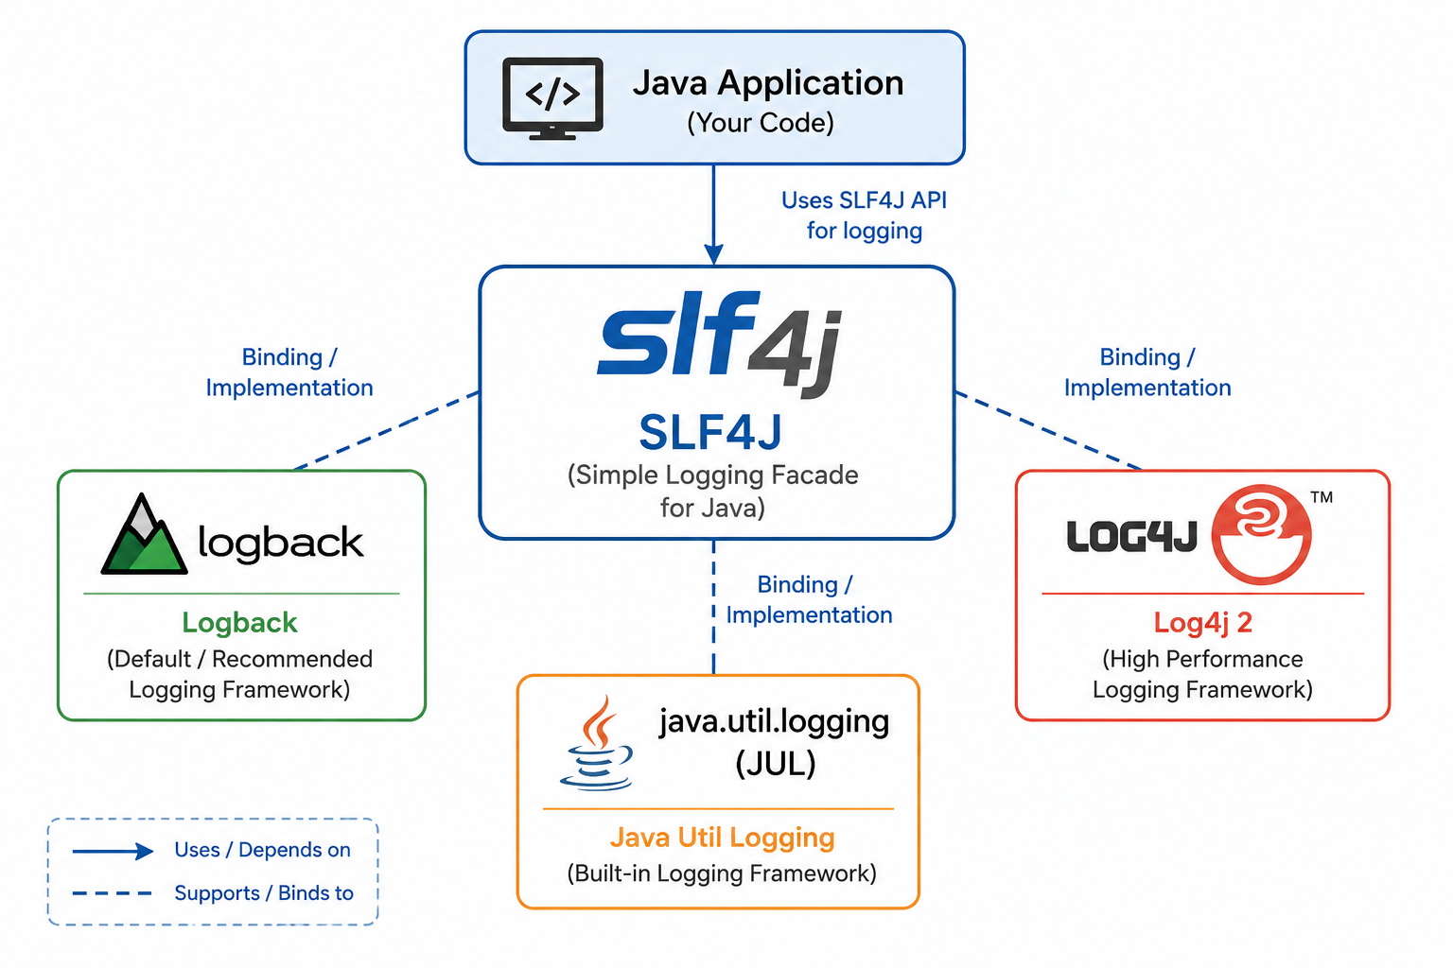
Supported Frameworks
Logback
Log4j
java.util.logging

Slide 25
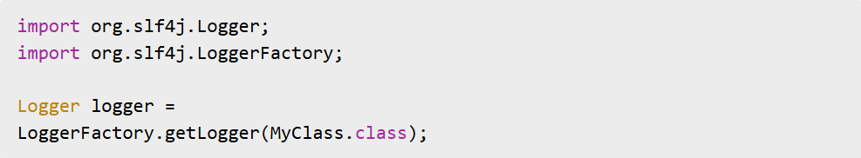
Creating Logger Using SLF4J
Logger Initialization
Example
Purpose
Creates a logger object to record messages

Slide 26
Logging Levels in SLF4J
Level Purpose
TRACE Very detailed information
DEBUG Debugging details
INFO General information
WARN Warning situations
ERROR Serious issues
Importance
Helps categorize messages according to severity

Slide 27
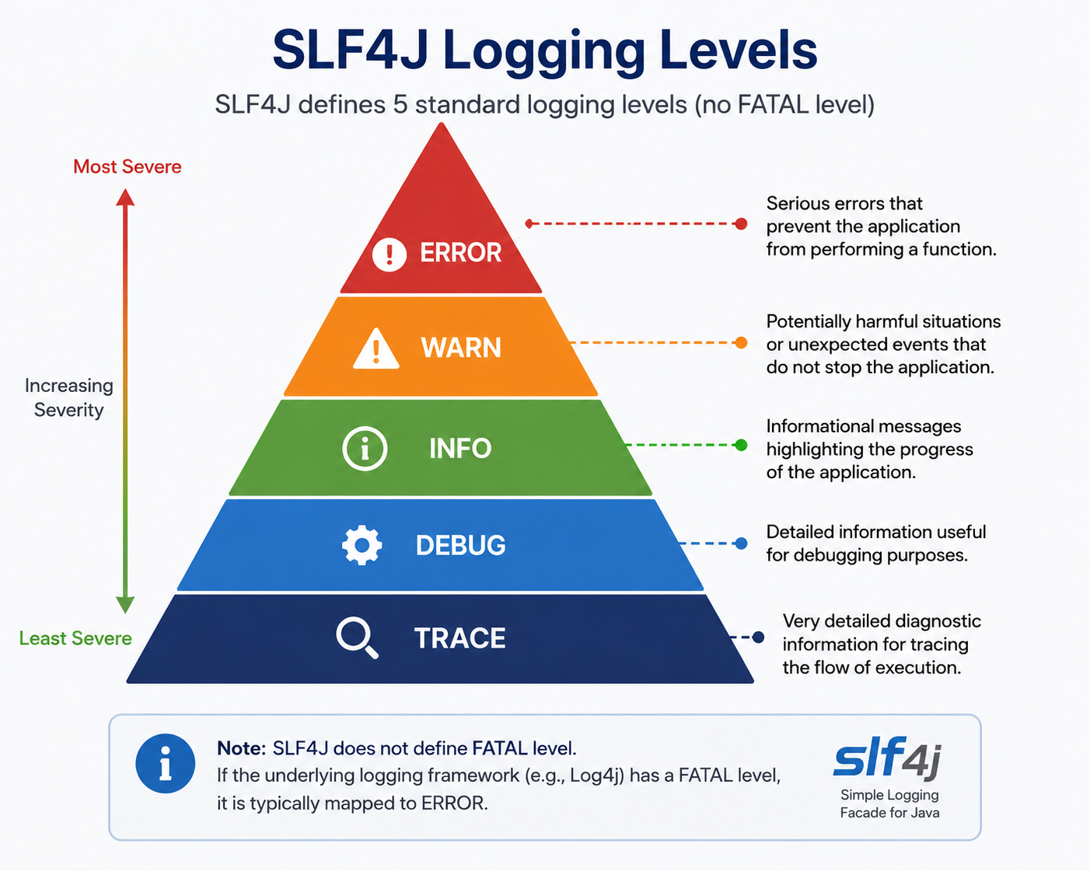
Pictorial Representation

Slide 28
SLF4J Logging Example
Logging Messages
Example
logger.info("Application started");
logger.debug("Debugging mode enabled");
logger.error("Database connection failed");

Slide 29
Introduction to Debugging
What is Debugging?
Process of identifying, analyzing, and fixing software bugs
Remove software defects
Improve code quality
Ensure correct program behavior
Debugging is essential for producing reliable software systems.

Slide 30
Common Types of Bugs
Syntax Bugs : Violations of programming language rules
Runtime Bugs: Occur during execution
Logical Bugs: Program runs but produces incorrect results
Integration Bugs: Occur when multiple modules interact incorrectly

Slide 31
Debugging Techniques
1. Print Statement Debugging
Displays variable values at different points in the program
Example
int a = 10;
int b = 20;
System.out.println("Value of a: " + a);
System.out.println("Value of b: " + b);
System.out.println("Sum: " + (a + b));
Use:
Helps check if values are correct
Simple and quick debugging method

Slide 32
2. Step-by-Step Execution
Run code line by line using a debugger tool
Example
int x = 5;
int y = x * 2;
int z = y + 10;
System.out.println(z);
How it works:
Step 1: x = 5
Step 2: y = 10
Step 3: z = 20
Use:
Helps understand program flow

Slide 33
3. Code Review
Other developers check code to find mistakes
Example
Developer A writes:
if(age = 18) // mistake
Developer B corrects it:
if(age == 18)
Use:
Finds logical and syntax errors
Improves code quality

Slide 34
4. Unit Testing
Testing small parts (functions) individually
Example
int add(int a, int b){
return a + b;
}
Test Case:
Input: 2, 3
Expected Output: 5
Ensures each function works correctly

Slide 35
5. Log Analysis
Study system logs to find errors
Example
INFO: Application started
ERROR: Database connection failed
WARN: Low memory detected
Use:
Helps trace real system issues
Useful in production systems

Slide 36
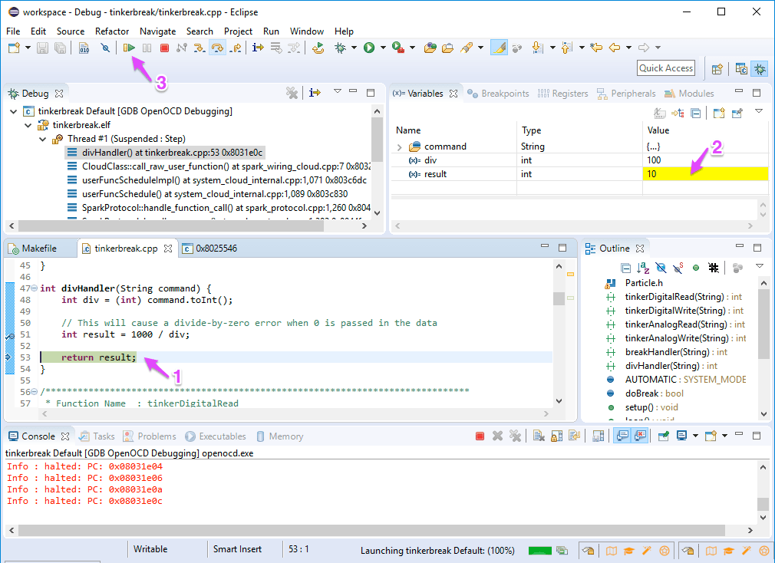
Popular Debugging Tools
IntelliJ IDEA Debugger
Eclipse Debugger
Java Debugger (JDB)
VisualVM

Slide 37
Error Handling and Fault Tolerance
Error Handling
Refers to detecting and responding properly to software errors
Prevent system failure
Maintain smooth execution
Provide user-friendly messages
Fault Tolerance
Ability of a system to continue functioning even after failures occur
Examples
Backup servers
Retry mechanisms
Redundant databases

Slide 38
Fault Tolerance Strategies
Techniques for Fault Tolerance
Retry Mechanism (Retry failed operations automatically)
Redundancy (Maintain backup systems)
Graceful Degradation (Reduce functionality instead of complete shutdown)
Failover Systems (Switch to backup systems automatically)
Data Backup and Recovery (Protect important information)

Slide 39
Thank You!

